Slide 1


Predicting A Stroke Using Machine Learning
Using PYTHON

Slide 2


Group - 09
SUDARSHAN SAHA BISHAL
ID: 20-42915-1
HIMEL DATTA
ID: 19-41576-3
FABIHA TASNIM
ID: 20-43426-1
MD. SHAHRIAZ ZAMAN
ID: 18-38692-3

Slide 3

OUTLINE
Problem Statement
Objectives
Methodology
Results & Discussion
Conclusion
References

Slide 4
PROBLEM SATEMENT
“Is it feasible to develop a model that can generate reliable predictions for stroke?”

Slide 5
OBJECTIVES
1. Develop an accurate machine learning model that can predict an individual stroke based on various factors.
2. Exploring and identifying the most important features or risk factors associated with stroke and incorporating them into the model.
3. Comparing the performance of different machine learning algorithms in predicting stroke and selecting the most appropriate one.
4. Evaluating the impact of data preprocessing techniques, such as feature scaling and imputation, on the model's performance.
5. Providing insights and recommendations for healthcare professionals and policymakers to prevent and manage stroke.

Slide 6
METHODOLOGY
1. Data Collection Procedure
2. Data Validation Procedure
3. Data Preprocessing and Normalization
4. Feature Extraction Procedure
5. Classification Algorithm
6. Data Analysis Techniques

Slide 7
METHODOLOGY
Data Preparation
Individual Model Training
Block Diagram for the Proposed Ensemble Model
Model Evaluation
Ensemble Model Creation
Ensemble Model Evaluation
Model Tuning
Final Model

Slide 8
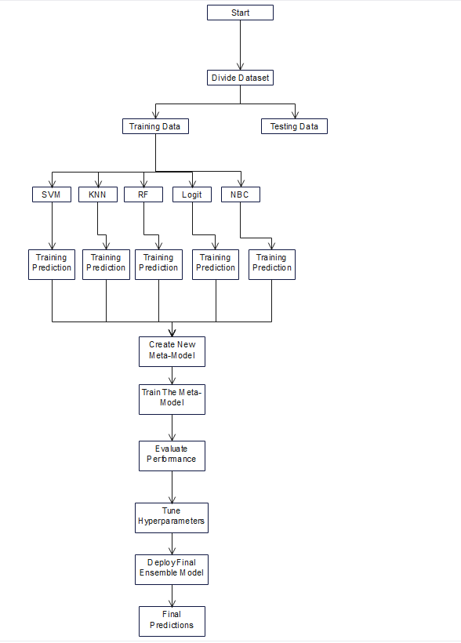
METHODOLOGY
Workflow Diagram for the Proposed Ensemble Model

Slide 9
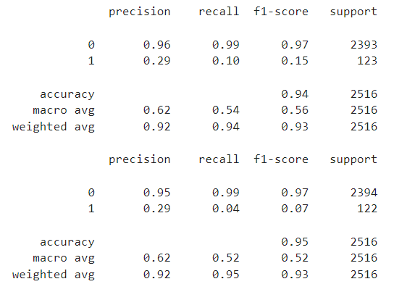
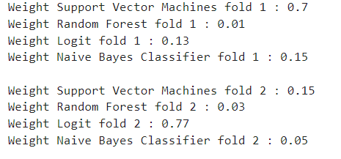
RESULTS & DISCUSSION
Result of Ensemble Model | Evaluation of Ensemble Model

Slide 10
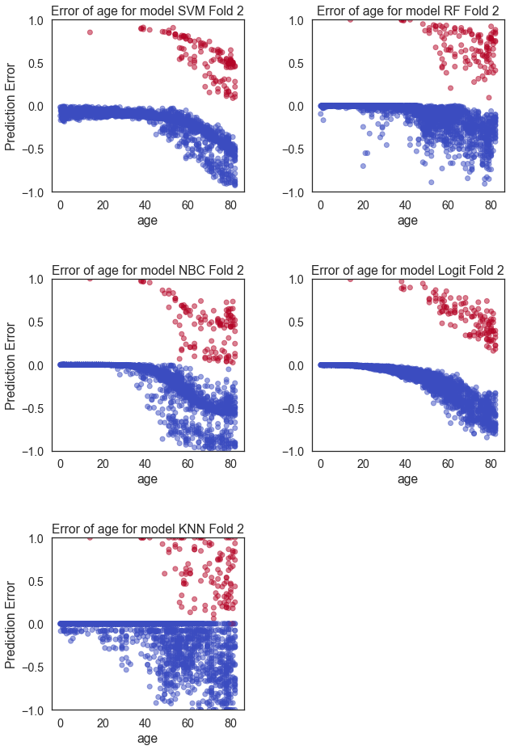
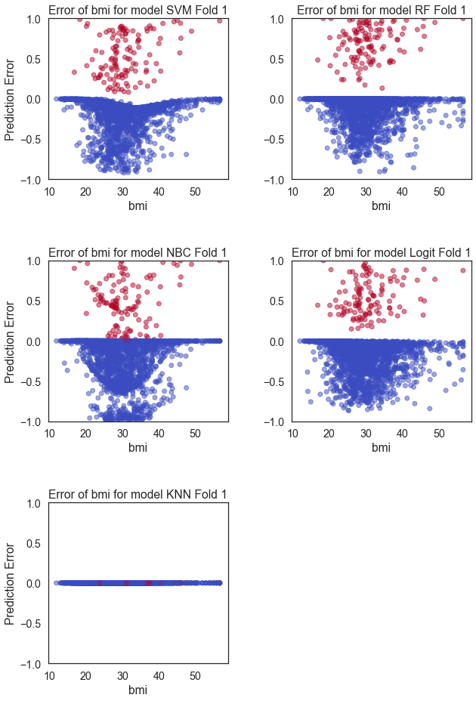
RESULTS & DISCUSSION

Slide 11
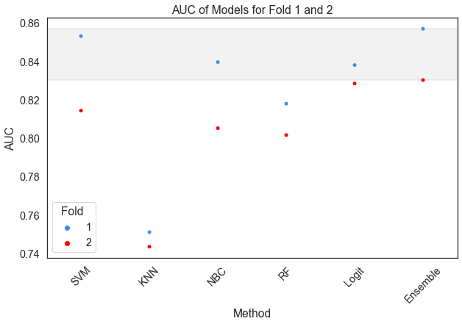
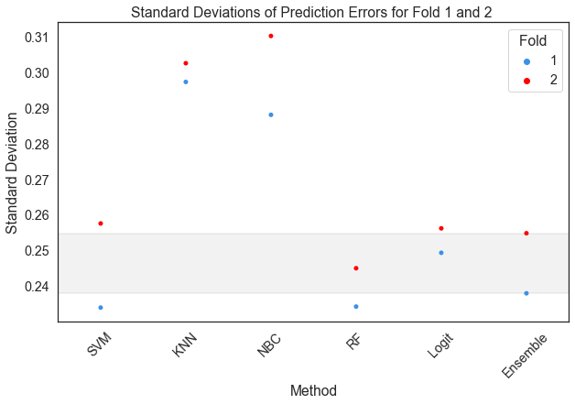
RESULTS & DISCUSSION

Slide 12
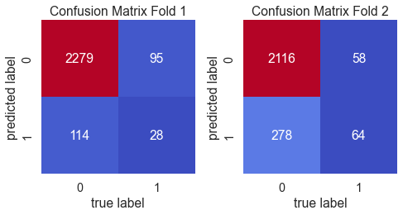
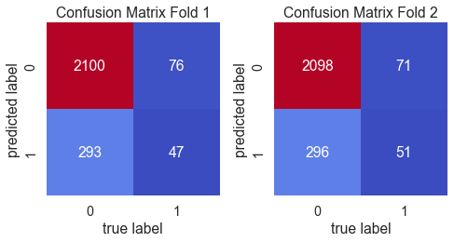
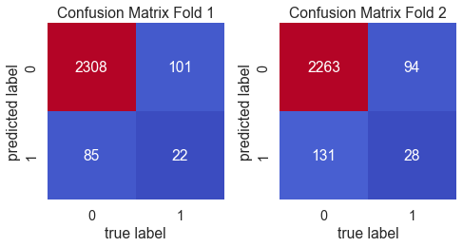
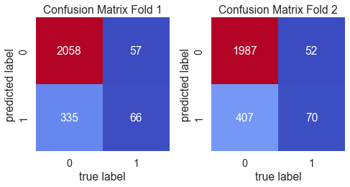
RESULTS & DISCUSSION
SVM | KNN | RF | NBC | Logit

Slide 13
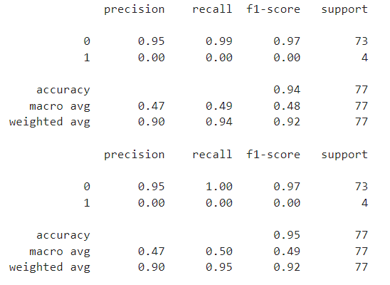
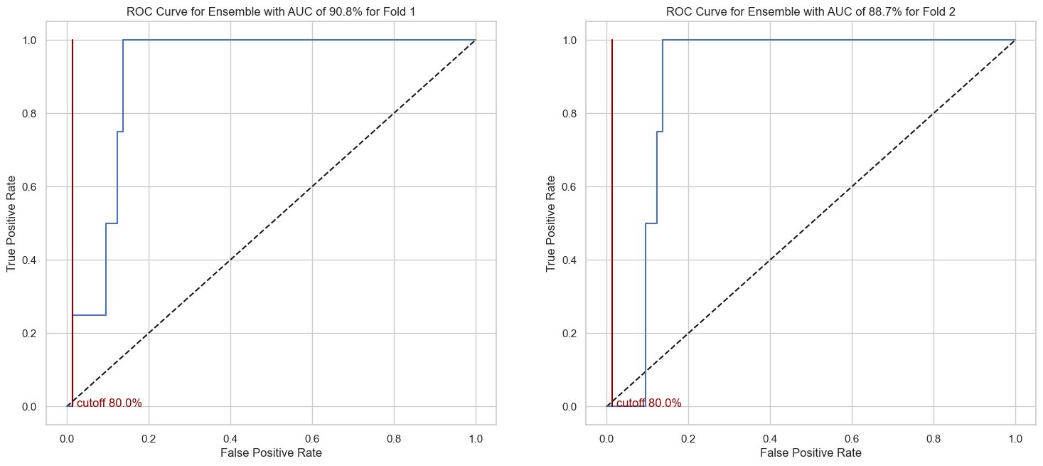
CONCLUSION
The ensemble gives 94% accuracy for fold1 and 95% for fold2.

Slide 14
REFERENCES
Benjamin, E. J., Blaha, M. J., Chiuve, S. E., Cushman, M., Das, S. R., Deo, R., ... & Turner, M. B. (2017). Heart disease and stroke statistics-2017 update: a report from the American Heart Association. Circulation, 135(10), e146-e603.
Lee, J., Hwang, J., Kim, Y. J., Park, H. J., Choi, S. Y., & Kim, J. W. (2019). Development of a stroke prediction model using electronic health record data. Journal of Stroke, 21(3), 330-340.
Lison, P. (2019). Python for machine learning. Springer.
Nguyen, T. T., Pham, T. D., Dao, T. H., & Phung, D. (2019). A machine learning approach for stroke prediction in Vietnamese patients with type 2 diabetes. Journal of medical systems, 43(5), 106.
Rathore, S., Reddy, D., Dandekar, S., & Abhishek, K. (2021). Stroke risk prediction using machine learning with multimodal brain imaging data. Journal of Healthcare Engineering, 2021.
Saber, H., Neshati, Z., Ebrahimpour, R., & Zolnoori, M. (2021). Predicting stroke occurrence using gradient boosting classifier. Computer methods and programs in biomedicine, 204, 106099.

Slide 15
THANK YOU

